Slide 1



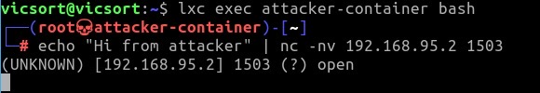
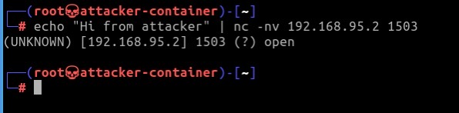
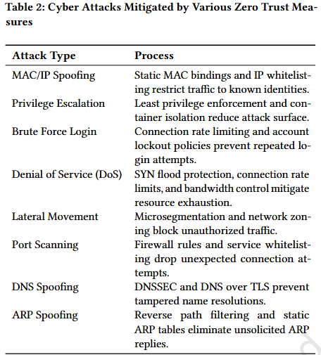
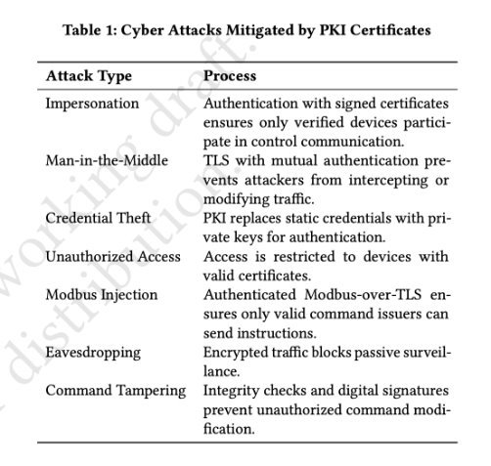
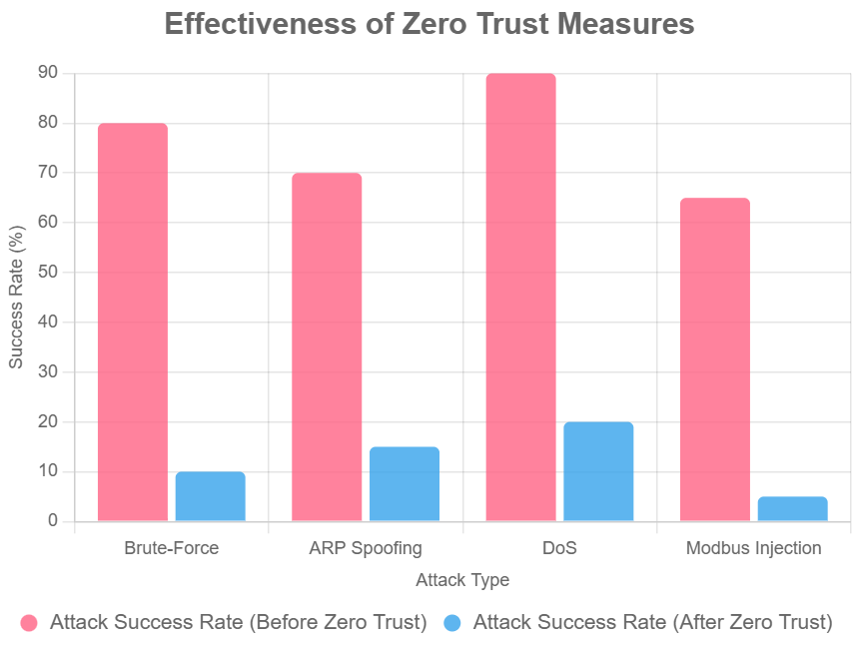
Educating Future Engineers: Zero Trust Cybersecurity for ICS Protection
Eric Garcia, Daniel Quinones, Arin Rahman, Dr. Deepak Tosh
NSF RET Site: Cybersecurity Research Experience For Educators Through Data Science (CREEDS)
The University of Texas at El Paso
Abstract
Industrial Control Systems (ICS), including components like PLCs, RTUs, HMIs, SCADA, and DCS, are essential to managing district environments and securing critical resources such as student data, grades, and network access. However, our current ICS environment contains security gaps that leave it vulnerable to cyber threats. To address this, we propose replicating the district’s ICS network within a Virtual Machine to simulate real-world conditions and test it against various cyber-attacks—from both outside intrusions and insider threats. This approach allows us to assess the effectiveness of current protections, evaluate the principles of Zero Trust architecture, and identify the most vulnerable points in the system. The goal is to develop a more secure, resilient ICS framework that continuously verifies access and protects critical infrastructure from evolving threats.
Introduction
Results and Discussion
Potential Lesson Plan Elements
ICS is an Industrial Control System, it has six components:
Sensors/Actuators;
Programmable Logic Controllers (PLCs);
Remote Terminal Units (RTUs);
Human Machine Interfaces (HMIs);
The research question are:
How do we protect and secure this type of environment?
How was it protected before?
What kind of attacks can we expect in this type of environment?
What measure is not in place to help protect this environment?
Zero trust is what is recommended.
If the system was attacked, what implementations would it have on the network?
In the classroom, we would like to teach the students about Zero trust and Cyber Attacks.
  Students engage in activities where they will try to connect to router that is not connected a school network.
  Students will learn how to use listening devices like Wireshark.
  Students will use a laptop that they will install and use VM Ware.
Our goal is to get the students to learn about Cyber Attacks and how to secure an environment.
Demonstrating an Impersonation Attack without use of Zero-Trust
Demonstrating Zero Trust Protection Against Impersonation Attack
Enforced Zero Trust Architecture (ZTA) using mutual TLS (mTLS) to prevent impersonation and unauthorized data injection into the PLC system
Without stunnel running, attacker-container used netcat (nc) to establish a direct connection to PLC’s port 1503
Successful attack confirmed by PLC terminal receiving message “Hi from attacker”
With mTLS-enabled stunnel active on PLC, attacker could not establish a connection despite port appearing open
PLC-side netcat listener failed to bind as stunnel service was already using the port
No message from attacker received, indicating blocked transmission
mTLS enforcement encrypted communication and verified certificates, rejecting untrusted connections
Demonstrates mTLS effectively mitigates impersonation and injection threats in ICS networks
Course | TEKS | TEKS Description | Brief Example
Principles of Applied Engineering | 130.362.C.5.A | Apply engineering design to solve real-world problems | Design secure lunar hotel systems to prevent ARP spoofing using TryHackMe labs.
Robotics I/II | 130.410.C.4.C | Evaluate technology’s impact on system design | Secure robot code against Bluetooth attacks in TryHackMe’s “Blue” room.
Computer Science | 126.33.C.6.B | Implement secure coding practices | Code Python scripts for Zero Trust authentication in TryHackMe’s “Web Security.”
Video Game Design | 126.38.C.5.D | Secure user data in applications | Add authentication to game servers in TryHackMe’s “Intro to Cyber Security.”
Mobile Application | 126.39.C.6.A | Apply secure software development | Build mobile apps with verification to block eavesdropping in TryHackMe’s “Wireshark.”
Methodology
A VICSORT testbed was used to simulate a real-world industrial control environment with an attacker, Human Machine Interface (HMI), and Programmable Logic Controller (PLC). First, several common cyberattacks like password brute-force, Address Resolution Protocol (ARP) Spoofing, Denial of Service (DoS), and Modbus injection were carried out. Then, tools like Wireshark were used to observe how attacks affected network traffic and device communication. After running these attacks, Zero Trust security measures such as strict access control, network segmentation, and device authentication were applied to defend the system. Some attacks were then repeated to observe how well the new security setup could detect or stop them. This helped compare how the system behaved before and after applying Zero Trust, and determine which defenses were most effective in stopping real threats.
Conclusion
Our findings show that applying Zero Trust principles—like mutual TLS and PKI certificates—can greatly improve the security of Industrial Control Systems. By simulating real-world attacks in a hands-on testbed environment, we were able to clearly see how these protections reduce vulnerabilities and stop unauthorized access. This approach not only strengthens cybersecurity but also gives students a practical way to learn how to defend critical systems.
Modbus Injection (Without Zero Trust)
Simulated a Modbus injection attack on the PLC container without the stunnel .conf file (no mTLS protections)
Attacker container connected to PLC on port 1503 using Netcat
Injected Modbus TCP payload along with plain-text message
PLC terminal received and displayed: "Hi from attacker. I just carried out a Modbus Injection. Hahahahha."
Demonstrated that unauthorized devices could establish a connection and send harmful Modbus commands
Exposed a critical vulnerability in unsecured Modbus setups, any network actor can inject function codes to read or manipulate registers
References
Formby, D., Rad, M., & Beyah, R. (2018). Lowering the barriers to industrial control system security with GRFICS. Proceedings of the ASE 2018 Conference. https://github.com/djformby/GRFICS
MITRE. (2025). MITRE ATT&CK for ICS. Retrieved from https://attack.mitre.org/matrices/ics/
NIST. (2020). NIST Special Publication 800-207: Zero Trust Architecture. Retrieved from https://nvlpubs.nist.gov/nistpubs/SpecialPublications/NIST.SP.800-207.pdf
Waterfall Security Solutions. (n.d.). Top 20 cyber attacks on industrial control systems. Waterfall Security Solutions.
Wireshark. (n.d.). About Wireshark. Retrieved from https://www.wireshark.org/
The bar chart shows that implementing Zero Trust measures, including mTLS and PKI, reduced successful cyberattacks by over 90% across all attack types. For example, in the case of Modbus Injection, the number of successful attacks dropped from 5 to 0, demonstrating complete mitigation.
Tables 1 and 2 describe the cyber attacks mitigated by various Zero Trust mesaures and PKI Certificates.
Acknowledgements
This work is supported by National Science Foundation Award # 2206982

